Slide 1
Mall-E: Your perfect mall companion app
Presented by Team RunTime Error

Slide 2
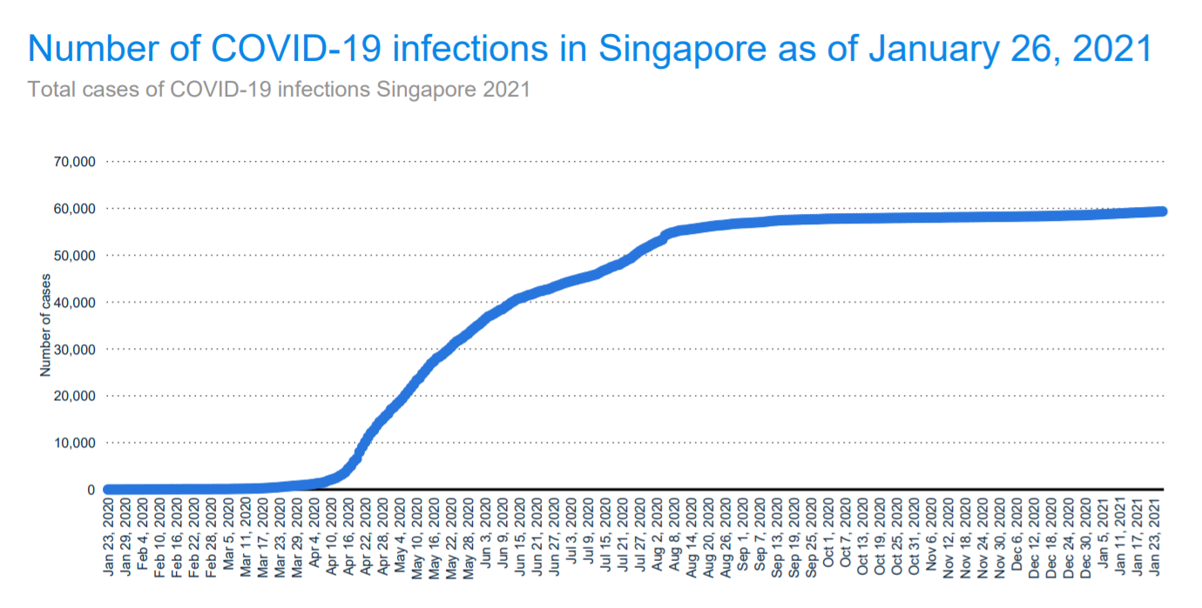
Problem Statement
COVID-19 infections in Singapore seem to have plateaued since the start of Phase 3 in December, 2020
Citizens need to be cautious since the lockdown rules have been minified but the virus still remains
People are going out to malls and restaurants but they have to follow MOH’s safe-distancing-measures
Our app takes the responsibility for your health into our hands!

Slide 3
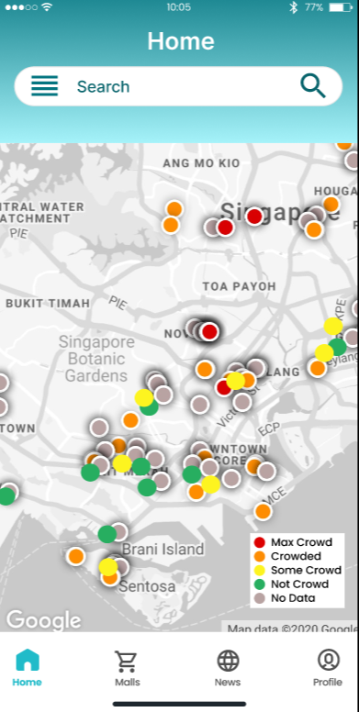
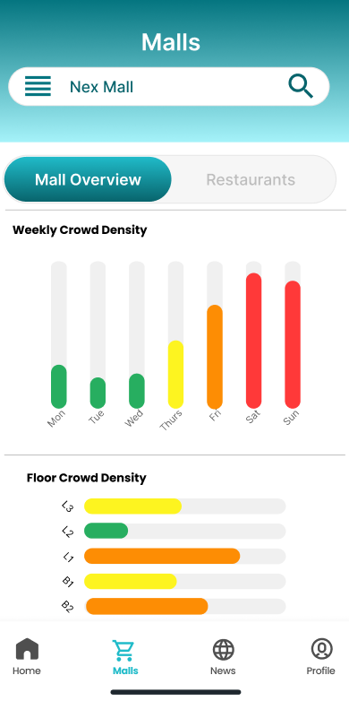
Our Solution
The Mall-E app attempts to be a one-stop shop for all your outing needs by fulfilling the following objectives:
Providing close monitoring on crowd levels in malls in Singapore
Providing waiting/queue times for restaurants in malls in Singapore
Raising awareness of COVID-19
Home page
Mall Detail page

Slide 4
Functional Requirements
01
Check Crowd Density of Malls
Map containing colored markers (based on crowd density) highlighting the malls
Graph of overall crowd density per hour scraped from Best Time API
02
Check Waiting/Queue Times of Restaurants
List of restaurants in that mall, each listing contains the name, cuisine, rating, location, description, and a picture of the restaurant
Data scraped from Google Popular Times API
03
Display News related to COVID in Malls in Singapore
Display the top 5 news articles from Google News related to COVID in Singapore malls
Each article has a headline, a picture, and the first 50 words of the article truncated

Slide 5



Tech Stack
React Native for the Frontend framework
NodeJS for the Backend framework
MongoDB for the Database

Slide 6
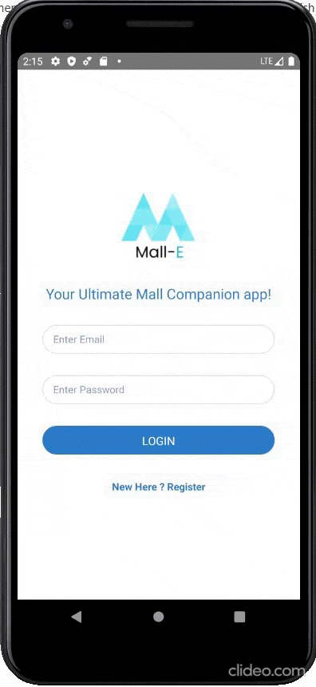
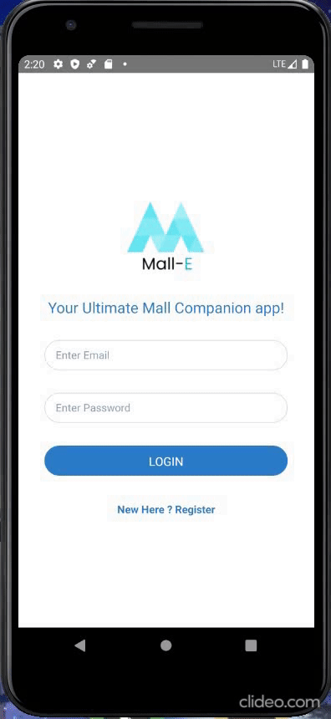
Login/Register
Error Handling:
Missing fields
Inaccurate password
Registering existing user
Login Credentials:
Name: Test1234
Email: test1234@test.com
Password: test1234

Slide 7
LIVE DEMO!

